Slide 1
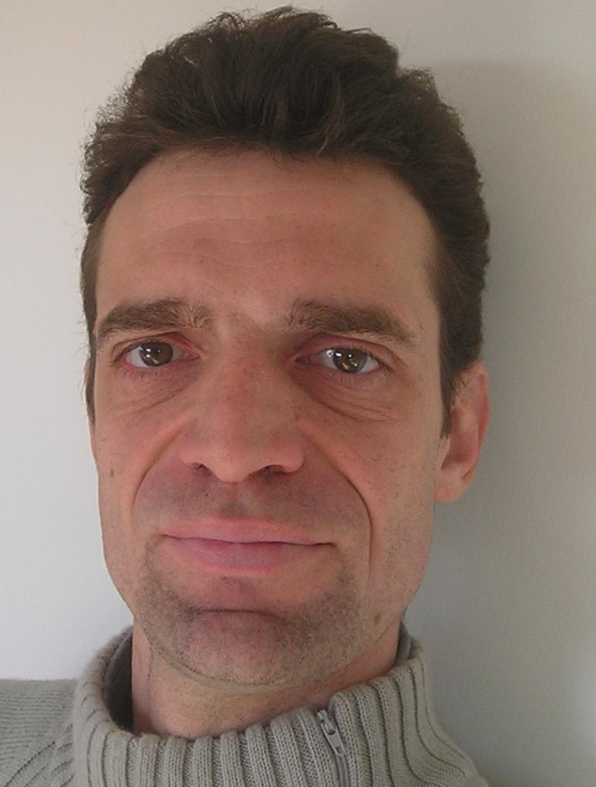


Your
Photo
here
Pierre Durand
Chief Technical Officer
mezzònomy
ADDRESS
6 rue des Tamaris
31700 Blagnac
France, EU
PHONE
+336.32.97.90.27
EMAIL
pierre.gradit@mezzonomy.com
WEBSITE
-
Work Experience
mezzònomy
Platform Architect
Jun. 2008 - present
Multiple experience and proof of concepts of use of an alternative graph theory called « hypertext algebra ». Realisation of a proof of concept of graphical programming in 2011 and a full blockchained text editor in 2015.
Samtech France
Computer Expert
Apr. 2005 – Jun. 2008
Date of Birth: Nov, 20, 1971
Place of Birth: Toulouse
Nationality: French
Martial Status: Married
Participation to a transdisciplinary and transnational project to provide common methods to all AIRBUS engineers in the field of structural analysis mixing metallicand composite and with numerous static and fatigue criteria.
Gdtech France
Project Manager
Sep. 2001 – Apr. 2005
Embedded softwares for aeronautic and medical devices. Conception and realisation of an XML/XLS platform to speed-up and strenghten these deveopments.
Professional skills
Computer Skills
Languages
Misc.
Theory
Specification
Design
Test
Maintenance
Python
XSL
TCL/TK
FORTRAN
C/C++/Java
LATEX
HTML/javascript/CSS
Parallel Programming
Petri Nets
Graph Grammars
Distributed systems
Hypertext Algebra
Blockchain
1/2

Slide 2
Education
Toulouse III (Paul Sabatier)
PhD Computer Science (21. Dec 2000)
Sep. 1997 – Sep. 2001
Thesis on the “specifications and designs of cooperative applications" in the OLC group of the LAAS/CNRS. Publications on the field of distributed mutual exclusion algorithms, workflows, comparative study of formal models, model-checking.
Ecole Normale Supérieure de Lyon
Master degree in Computer Science
Sep 1991 – Sep 1995
Study on parallel computing and cellular automata, compilation and semantics of programming languages, distributed programming and Lamport clocks,
Awards & Achievements
Awards
Achievements
Misc.
None yet.
Hypertext Algebra
Patent on partial sharing
Interests
Playing music – Piano, Drums, Voice, Murali
Reading scientific publications
Playing go
Being a concerned citizen
Gardening
References
Available on request
2/2

